Slide 1

Repository and Unit of Work
Part 2

Slide 2

Data Mapper Layer
„A system with a complex domain model often benefits from a layer, such as the one provided by Data Mapper, that isolates domain objects from details of the database access code.”
(Martin Fowler)

Slide 3
Data Query Layer
„In such systems it can be worthwhile to build another layer of abstraction over the mapping layer where query construction code is concentrated.”
(Martin Fowler)

Slide 4
Repository
„A Repository mediates between the domain and data mapping layers, acting like an in-memory domain object collection.”
(Martin Fowler)

Slide 5
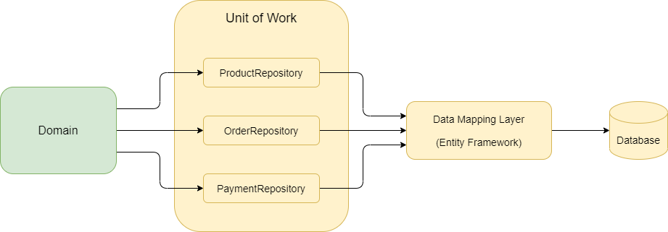
Unit of Work
“The Unit of Work maintains a list of objects affected by a business transaction and coordinates the writing out of changes.”
(Martin Fowler)

Slide 6
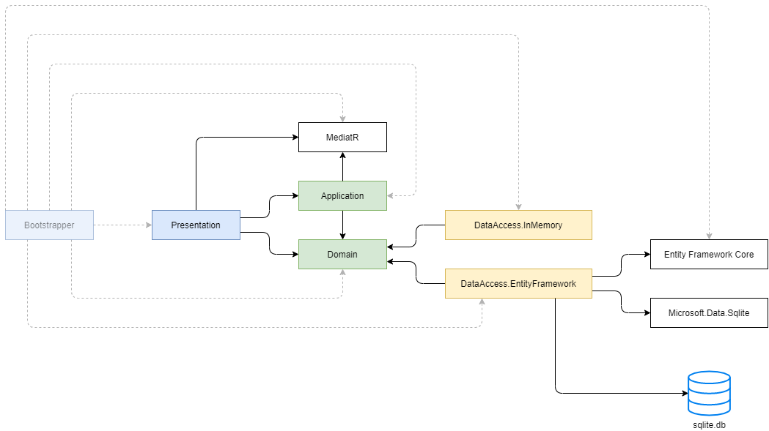
Architecture Diagram

Slide 7
Topic 1 Return IQueriable from Repositories
public class ProgramRepository
{
public IQueriable<Program> GetAll()
{
return dbContext.Programs
.Where(x => x.Name == "Boston Program");
}
}

Slide 8
Topic 2 Entity Framework vs Custom Repositories
DbSet<T> is a Repository
(+) Hides the details of accessing the data
(+) Emulates an in-memory collection
(-) We have no place where to write custom queries that can be later used in multiple places in the rest of the application.
DbContext is a Unit of Work
(+) Ensures data consistency
It provides the `SaveChanges` method.

Slide 9
Topic 3 Queries in Extension Methods
Instead of creating Repositories, if we only need a place where to put the queries, we can create extension methods over `DbSet<T>`.

Slide 10
Thank you

